Slide 1
Requirements Engineering
COMP6100001 - Software engineering
Session 06
Kenny Jingga, S.Kom., M.T.

Slide 2
Session 06 – Requirement Engineering
Learning objectives
At the end of this session, students will be expected to be able to:
Explain the role and importance of RE (including Agile)
Identify and analyze stakeholders
Select elicitation techniques
Explain and apply the seven RE tasks
Apply RE to a realistic case study

Slide 3
Session 06 – Requirement Engineering
Content outline
Requirements engineering concepts
Stakeholders
Requirement types
Elicitation techniques
Analysis & validation
Requirements monitoring & management

Slide 4
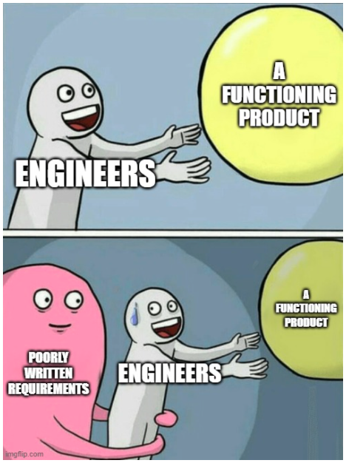
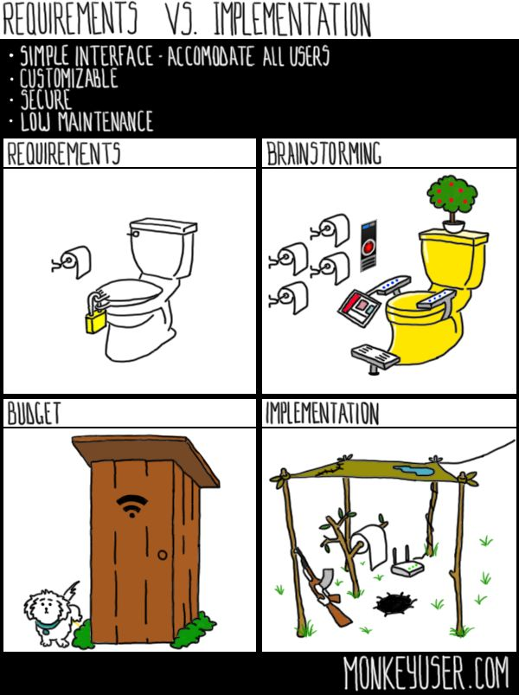
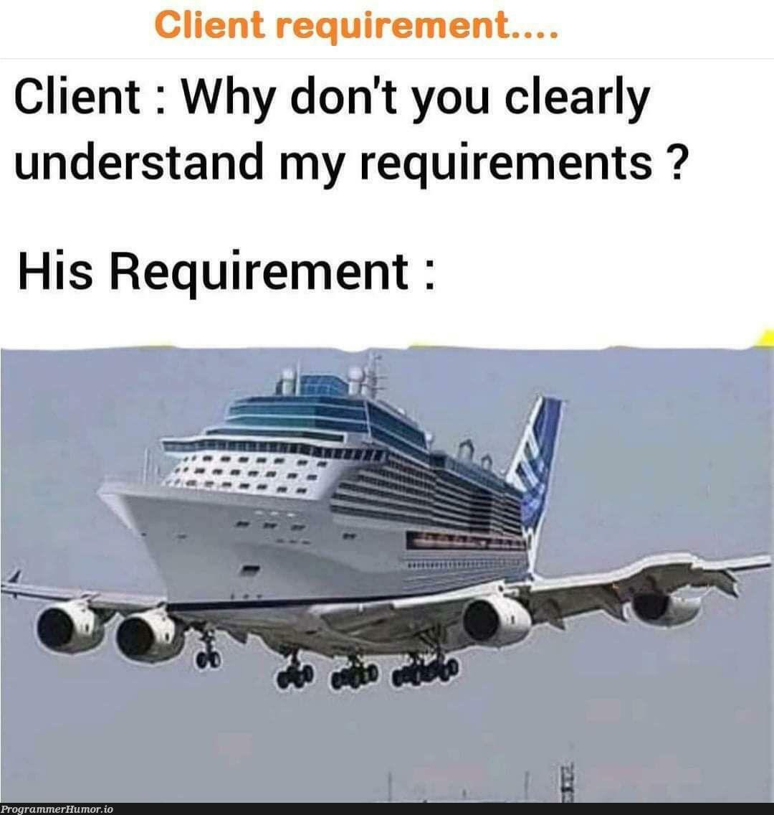
Introduction to Requirements Engineering

Slide 5
Introduction to Requirements Engineering
Importance of Requirements Engineering
Requirements Engineering (RE) is the process of defining, documenting, and maintaining the requirements in the engineering design process.
Importance:
Foundation for Development: Requirements serve as the foundation for all subsequent development activities.
Stakeholder Satisfaction: Ensures the final product meets the needs and expectations of stakeholders.
Risk Reduction: Identifies potential issues early, reducing the cost and time associated with rework.
Scope Management: Helps in defining the project scope and prevents scope creep.

Slide 6
Stakeholder identification and analysis
Identifying and analyzing stakeholders
Who are Stakeholders?
  Individuals or organizations affected by or can affect the system.
  Types:
    Users: Primary users, secondary users.
    Clients: Those who commission the system.
    Developers: Team members building the system.
    Regulators: Authorities enforcing standards and regulations.

Slide 7
Stakeholder identification and analysis
Identifying and analyzing stakeholders
Stakeholder Analysis:
  Purpose: Understand stakeholders' influence and interest.
  Steps:
    Identify Stakeholders: List all potential stakeholders.
    Assess Impact and Influence: Determine their level of impact and influence.
    Prioritize Stakeholders: Focus on key stakeholders.
    Understand Needs and Expectations: Gather initial insights.

Slide 8
Stakeholder identification and analysis
Managing stakeholder relationships
Communication: Establish clear channels and frequency.
Engagement: Involve stakeholders throughout the project.
Expectation Management: Align stakeholder expectations with project realities.
Conflict Resolution: Address disagreements promptly and professionally.

Slide 9
Types of Requirements
Functional vs Non-Functional Requirements
Functional Requirements:
  Define what the system should do.
  Examples:
  “The system checks prerequisites before registration”
  "The system shall allow users to create and edit profiles."
  "The system shall generate monthly sales reports.”
Non-Functional Requirements:
  Define how the system performs its functions.
  Include constraints and qualities.
  Categories: Performance, Security, Usability and Reliability
  Examples:
  The system supports 10,000 concurrent users
  The system shall lock a user account after 5 consecutive failed login attempts.
  The system shall respond to user requests within 2 seconds for 95% of transactions under normal load.

Slide 10
Techniques for eliciting requirements
Overview of Elicitation Techniques
Purpose: Gather comprehensive requirements from stakeholders.
Challenges:
  Ambiguity: Unclear or incomplete information.
  Communication Barriers: Misunderstandings due to jargon or assumptions.
  Stakeholder Availability: Limited access to key stakeholders.

Slide 11
Techniques for eliciting requirements
Interviews
Types:
  Structured Interviews: Predefined set of questions.
  Unstructured Interviews: Open-ended conversations.
Best Practices:
  Preparation: Research and plan questions.
  Active Listening: Pay attention and clarify doubts.
  Recording: Take notes or record (with permission).

Slide 12
Techniques for eliciting requirements
Surveys and Questionnaires
Use When: Access to stakeholders is limited; need quantitative data.
Design Tips:
  Clear Questions: Avoid ambiguity.
  Logical Flow: Organize questions coherently.
  Pilot Testing: Test the questionnaire before distribution.

Slide 13
Techniques for eliciting requirements
Workshops and Focus Groups
Workshops:
  Collaborative sessions with stakeholders.
  Advantages: Foster collaboration, immediate feedback.
Focus Groups:
  Guided discussions with selected stakeholders.
  Advantages: Gain diverse perspectives.

Slide 14
Techniques for eliciting requirements
Observation and Ethnography
Observation:
  Watch stakeholders perform tasks.
  Benefits: Understand actual workflows and pain points.
Ethnography:
  In-depth study of users in their environment.
  Benefits: Gain deep insights into user behavior and culture.

Slide 15
Documenting Stakeholder needs and Expectations
Writing clear and concise requirement specifications
Guidelines:
  Clarity: Use simple, unambiguous language.
  Consistency: Maintain uniform terminology.
  Completeness: Cover all necessary aspects.
  Verifiability: Requirements should be testable.
Example of a Well-Written Requirement:
  "The system shall authenticate users using a username and password before granting access to the dashboard."

Slide 16
Analyzing and Validating Requirements
Requirement Analysis Techniques
Prioritization:
  MoSCoW Method: Must have, Should have, Could have, Won't have.
Modeling:
  Data Flow Diagrams (DFDs): Represent data movement.
  Entity-Relationship Diagrams (ERDs): Show data relationships.

Slide 17
Requirements traceability and management
Importance of traceability
Definition: Ability to link requirements to their origins and track them throughout the project.
Benefits:
  Impact Analysis: Understand effects of changes.
  Verification: Ensure all requirements are fulfilled.
  Accountability: Maintain records of decisions.

Slide 18
Requirements traceability and management
Tools for Requirements Management
Popular Tools:
  IBM Rational DOORS: For requirements management and traceability.
  Jama Software: Collaborative requirements management.
  Atlassian JIRA: With plugins for requirements tracking.
Features to Look For:
  Traceability Matrices: Visualize relationships between requirements and other artifacts.
  Collaboration Capabilities: Support team communication.
  Integration: Ability to work with other development tools.

Slide 19
Now that we know the tools, let’s see how requirements engineering work is organized conceptually.

Slide 20
Requirement Engineering
Requirements engineering includes seven core tasks:
Inception
Elicitation
Elaboration
Negotiation
Specification
Validation
Management
These tasks:
Do not occur strictly in sequence
Often overlap and run in parallel
Are adapted to each project
Notes:
“Requirements engineering is not a phase you finish and move on from.
You will always be doing some requirements work — even during design and implementation.”
“In real projects, boundaries are fuzzy.
You may refine requirements while designing, and adjust design while discussing requirements.”

Slide 21
Requirement Engineering
Inception: Understanding the Problem
Identify the business need
Understand who needs the system
Define the problem boundaries
Elicitation: Discovering Stakeholder Goals
Engage stakeholders through discussion
Identify functional and non-functional goals
Capture what success means
Elaboration: Refining Requirements
Refine user scenarios
Clarify system behavior
Identify key concepts and interactions

Slide 22
Requirement Engineering
Negotiation: Resolving Conflicts
Handle conflicting requirements
Prioritize based on value, cost, and risk
Reach agreements all parties can accept
Specification: Representing Requirements
Requirements may be documented as:
                Text
    Models
    Scenarios
    Prototypes
Level of formality depends on project size and risk

Slide 23
Requirement Engineering
Validation: Checking Requirement Quality
Ensure requirements are:
Clear
Consistent
Testable
Achievable
Detect errors, omissions, and ambiguity
Requirements Management: Handling Change
Track requirement changes
Maintain traceability
Control scope while accepting evolution

Slide 24
Requirement Engineering
Single Case Study: University Online Course Registration System
Case: Online Course Registration System
Problem:
Students struggle to register courses on time
Manual approvals cause delays
Errors lead to schedule conflicts
Goal:
Improve student experience
Reduce administrative workload

Slide 25
Requirement Engineering
Single Case Study: University Online Course Registration System
Inception: Understanding the Problem
Business need: faster, error-free registration
Stakeholders:
Students
Academic advisors
Registrar office
Scope:
Course selection
Schedule validation
Approval workflow

Slide 26
Requirement Engineering
Single Case Study: University Online Course Registration System
Elicitation: Discovering Stakeholder Goals
Stakeholder goals:
Students: register quickly, avoid clashes
Advisors: approve efficiently
Admins: enforce academic rules
Non-functional goals:
Availability during peak time
Security of student data

Slide 27
Requirement Engineering
Single Case Study: University Online Course Registration System
Elaboration: Refining Requirements
User scenarios refined:
Student selects courses
System checks prerequisites
System detects schedule conflicts
Advisor reviews exceptions
Key concepts identified:
Course
Student
Prerequisite
Schedule

Slide 28
Requirement Engineering
Single Case Study: University Online Course Registration System
Negotiation: Resolving Conflicts
Conflicts:
Students want unlimited course selection
University enforces credit limits
Resolution:
System allows requests beyond limit
Advisor approval required
Specification: Representing Requirements
Requirements represented as:
User stories (student actions)
Acceptance criteria
Simple workflow diagrams
Formality:
Lightweight documentation
Detailed rules for validation logic

Slide 29
Requirement Engineering
Single Case Study: University Online Course Registration System
Validation: Checking Requirement Quality
Validation checks:
“Fast registration” clarified as: Page loads < 2 seconds
“User-friendly” replaced with: Max 3 steps to register
Stakeholders review and confirm requirements.
Requirements Management: Handling Change
Change examples:
New prerequisite policy introduced
Course capacity rules updated
Management actions:
Update backlogTrace affected requirements
Revalidate impacted features

Slide 30
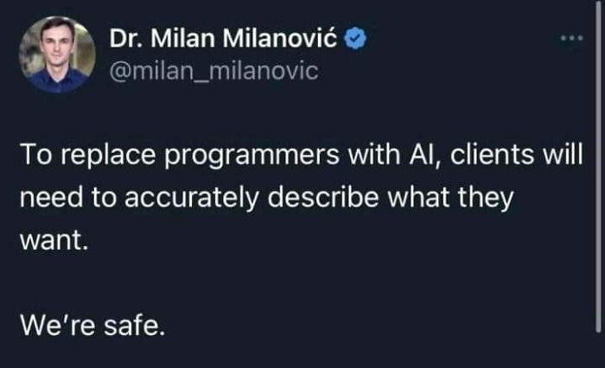

Slide 31
Case Study and Interactive Exercise
Case Study: Online Retail System
Scenario:
A company wants to develop an online retail platform that allows customers to browse products, place orders, and track shipments.
Tasks:
  Part 1: Identify key stakeholders.
  Part 2: Choose appropriate elicitation techniques for gathering requirements from these stakeholders.
  Part 3: Write one functional and one non-functional requirement based on the scenario.
  Part 4: Using the Online Retail System, briefly describe how requirements evolve across the seven RE tasks

Slide 32
References
Titus Winters, Tom Manshreck, and Hyrum Wright. (2020). Software Engineering at Google: Lesson Learned from Programming Over Time. 1st. O’Reilly Media. California. ISBN: 978-1492082798.
Roger Pressman and Bruce Maxim. (2020). Software Engineering: A Practitioner's Approach. 9th E. McGraw- Hill. New York. ISBN: 9781259872976.
Requirements Engineering / Specification, http://www.youtube.com/watch?v=wEr6mwquPLY
Collaborative Requirements Management, http://www.youtube.com/watch?v=tEXizjE05LA

